Slide 1



UNH SEDS
CEPS Engineering Organization
High Power Rocketry
University of New Hampshire
Students for the Exploration and Development of Space

Slide 2

University of New Hampshire
Students for the Exploration and Development of Space

Slide 3
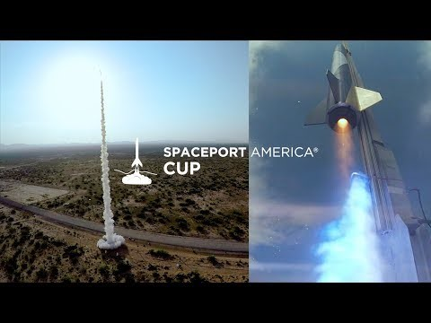
University of New Hampshire
Students for the Exploration and Development of Space

Slide 4







Project Overview
Design and test a hybrid rocket for Spaceport America Cup
Propulsion
Frame
Avionics/Payload/Recovery
Operations
Research thrust vector control on COTS engines
Feedback and Control
University of New Hampshire
Students for the Exploration and Development of Space

Slide 5

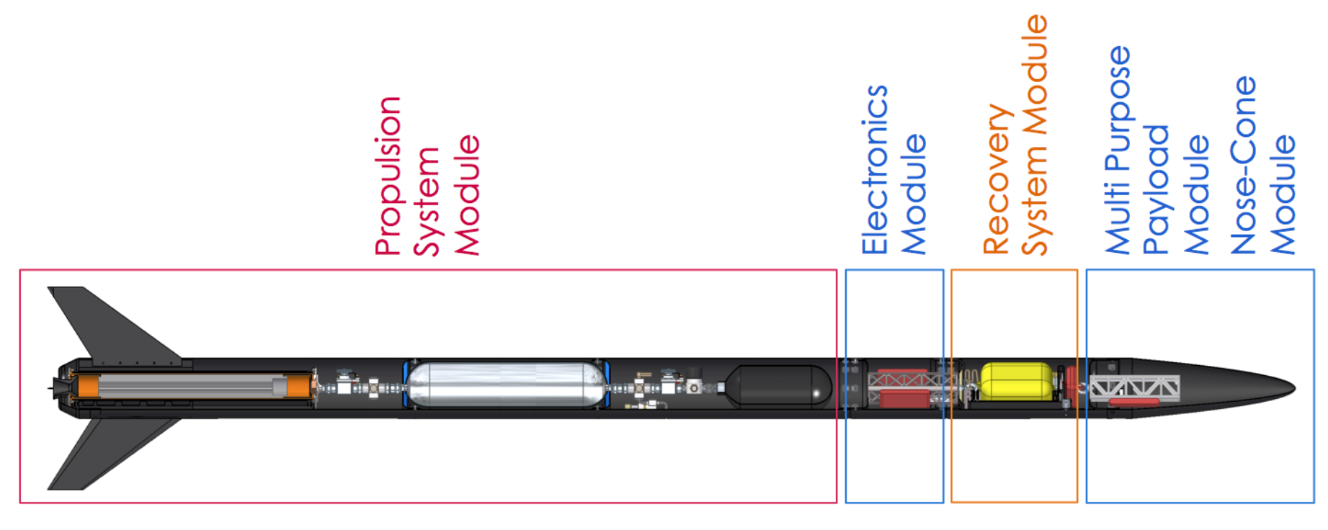
What is a Hybrid Engine Rocket?
Rocket is propelled via solid and liquid components
HTPB Rubber and Nitrous Oxide
Hydroxyl-terminated polybutadiene
Nose Cone
Parachute
Oxidizer
Injector Plate
Centering Rings
Combustion Chamber
Stabilization Fins
Nozzle
University of New Hampshire
Students for the Exploration and Development of Space

Slide 6
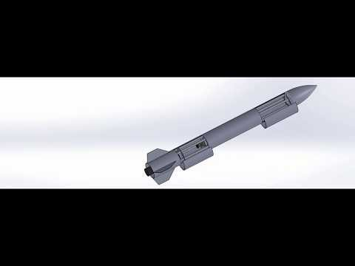
University of New Hampshire
Students for the Exploration and Development of Space

Slide 7
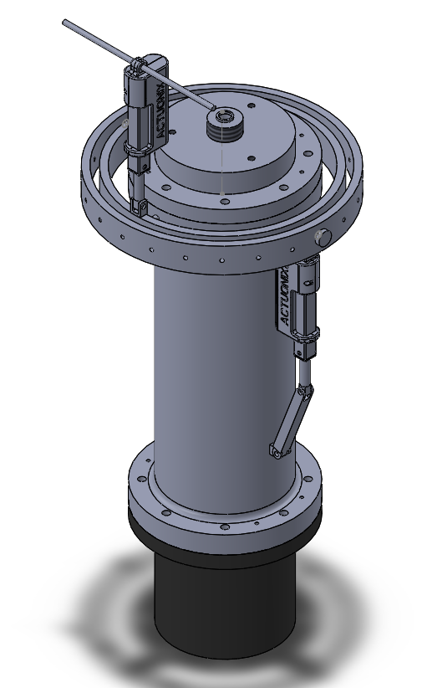

Gimbal System
Being able to control flight path of the rocket.
Controlled by two actuators.
Eventually get rid of rocket body fins to cut down weight of the rocket.
University of New Hampshire
Students for the Exploration and Development of Space

Slide 8
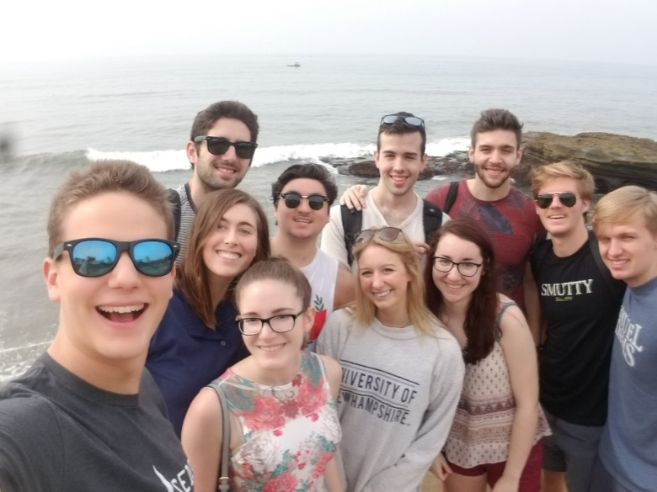
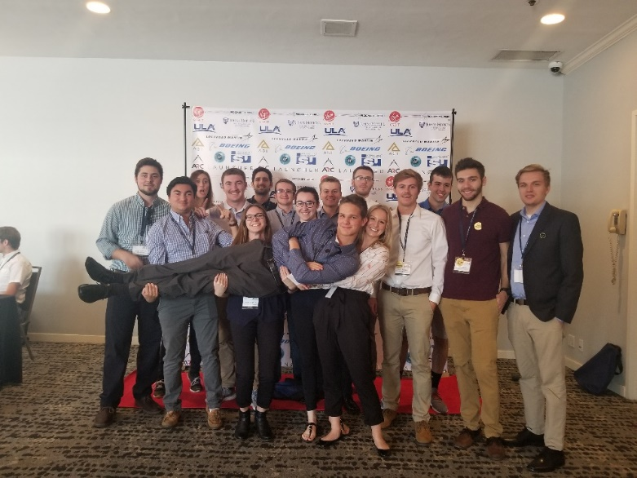
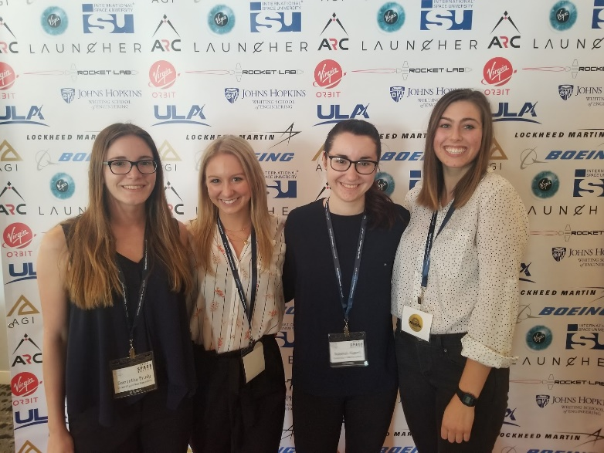
SpaceVision
SEDS USA hosts a national conference every year called ‘SpaceVision’ where many of the various SEDS chapters congregate to network and listen to speakers. This year, it will be on November 2019 in Arizona State University. We brought 16 of our members to take part in the 2018 SpaceVision located in San Diego California.
University of New Hampshire
Students for the Exploration and Development of Space
Notes:
EE major too

Slide 9
Networking Opportunities
University of New Hampshire
Students for the Exploration and Development of Space
Notes:
EE major too

